Slide 1
15Gifts MVP ETL Pipeline
Yagnesh Jadavji

Slide 2
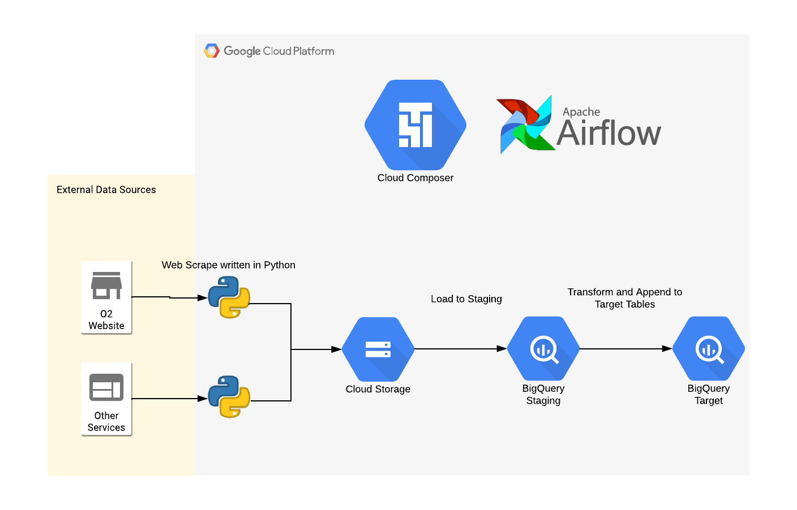
Architectural Approach
Scrape O2 website
Keep complexity modular
Leverage cloud resources
Make code reusable
Make data usable

Slide 3
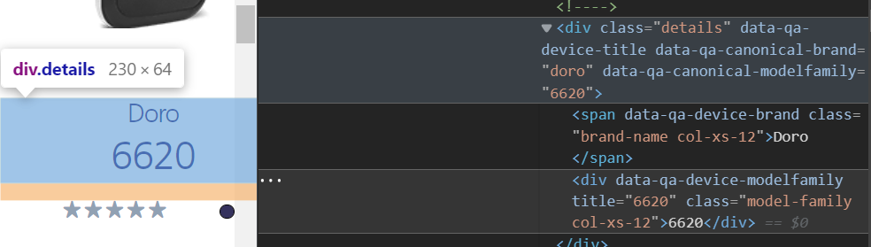
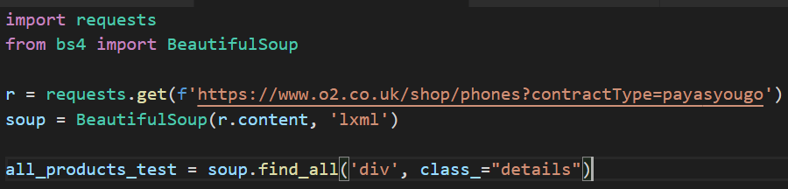
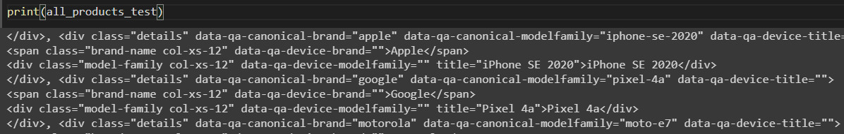
Web scrape approach
Product set
Decide upon the product set and identify the web pages they sit on. Here, phones – split across pay monthly and pay as you go.
Find the data you want to extract, and explore the underlying HTML by using ‘inspect’ function in browser
Individual Product data
Replicate in code
Request the website data programmatically and scan it for key elements
test
Test the code for a response

Slide 4
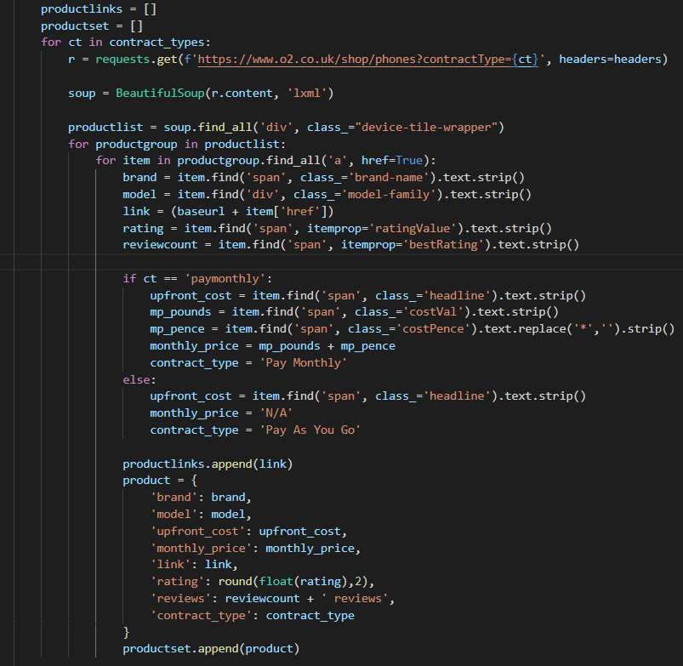
TOP LEVEL DATA DEEP DIVE
IDENTIFY TOP LEVEL DATA
Detail dataset scope. In this case, product brand and model data, rating and review data, O2’s ‘headline tariff’, and the link to each product
LOOP THROUGH PRODUCTS
Iterate through each product, grab the data identified above, and store it within a temporary structure

Slide 5
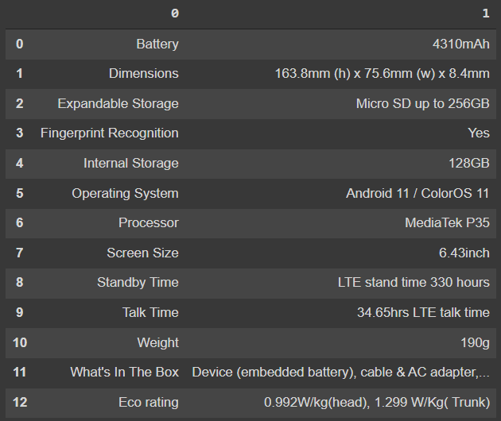
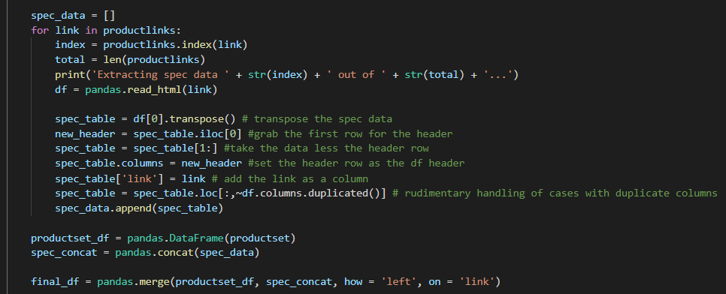
Second level data
IDENTIFY SECOND LEVEL DATA
Visit the page for an individual product and identify any desirable data on this page relating specifically to each product. In this case – a subset of the technical specification.
TRANSFORM AND APPEND
Extract the desired second level data and append to the top level data extracted earlier. Perform any necessary transformations to fit within desired data structure.

Slide 6

Final Steps
SEND THE DATA TO CLOUD STORAGE
Leveraging cloud resources, we package and send the data to the cloud storage repository of our choice
STAGE INTO DATA WAREHOUSE
Ingest data into data warehouse by loading file with minimal complexity, loading all data in as strings
INGEST FROM STAGING TO TARGET
Perform data transform to take data from the staging table and write into target, performing any data type conversions or aggregations here
EXPLORE AND VALIDATE THE DATA
Query the final data and perform any necessary tests against it

Slide 7
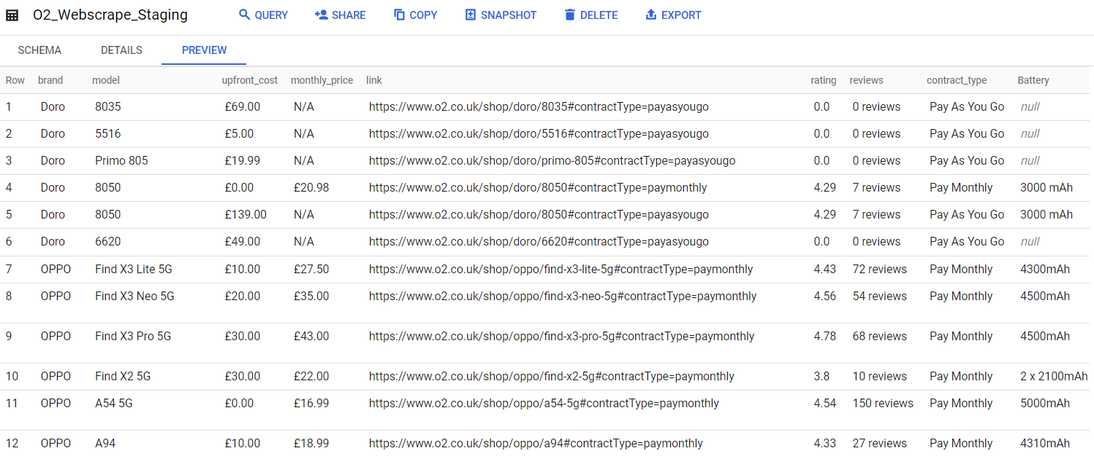
Data In cloud
Verify data exported correctly, and perform any checks and tests. Compare products.

Slide 8
OBSTACLES

Slide 9
OBSTACLES
SOME DATA CAN’T BE EXTRACTED WITH BEAUTIFULSOUP
Some data requires the web scraper to ‘wait’ for the page to load – this data can only be extracted with the use of a ‘webdriver’ – adding overhead and complexity
WILD VARIATION IN PRODUCT SPEC DATA
From product to product, the tech spec data varied tremendously and it was difficult to combine and compare specs across products
BAD DATA – DUPLICATE COLUMN NAMES
I encountered some examples where the data was poor and some column names were duplicated. This caused failure in my extraction process. To mitigate, I implemented a temporary workaround

Slide 10
FUTURE NEXT STEPS
ROBUSTNESS
Data ARCHITECTURE AND PIPELINE
EXPANDING SCRAPE
Implement error handling
Properly deal with column duplicates
Set up alerting and monitoring
Complete end-to-end pipeline into target dataset, enriching with relevant date references
Clean data and make it easier to compare products – minimising data gaps
Archive data into cloud storage
Extract all available tariffs besides just the headline tariff
Identify way to pull further spec data relating to comparison model
Enrich with additional data pulled from other sources

Slide 11
THANK YOU
Yagnesh Jadavji
Github:

